Slide 1


Hope to Skills
Lecture# 18
Irfan Malik, Dr. Sheraz Naseer

Slide 2
Agenda
Questions
Different Regression Models
Comparison of results
Quiz

Slide 3
Questions
MSE is very high Here are some Questions for you
What are the possible reasons for higher MSE Values?
What can we do to lower the value of MSE?

Slide 4
Feature Standardization and Transformation

Slide 5
Standardization
Standardization is a type of data preprocessing that makes different features have a similar scale.
Example
Suppose we have data on students' height in centimeters and weight in kilograms.
Heights might range from 150 cm to 180 cm, while weights might range from 40 kg to 80 kg.
Standardization scales both height and weight so they have similar ranges, like between 0 and 1.

Slide 6
Different Regression Techniques

Slide 7
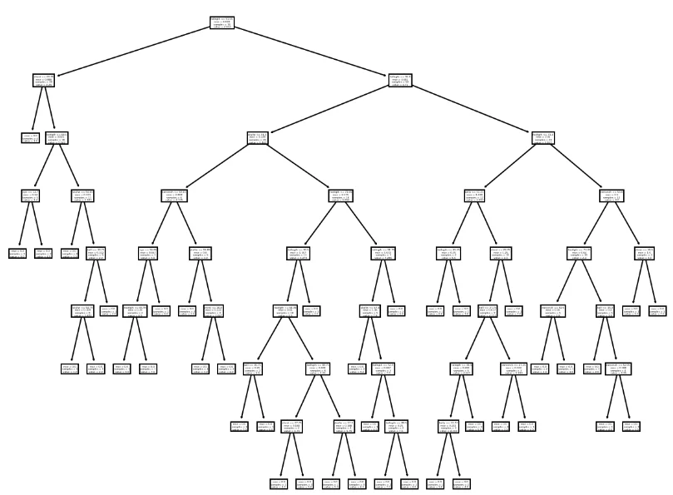
Decision Tree Regressor
Decision tree regression involves partitioning the data into subsets based on the values of independent variables and predicting the average of the target variable for each subset.

Slide 8
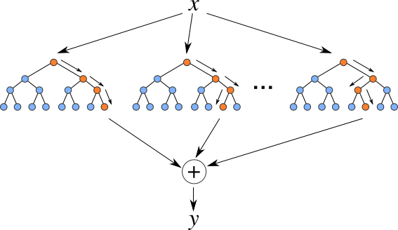
Random Forest Regressor:
Random Forest is learning method that creates multiple decision trees during training and outputs the average prediction (for regression) from all individual trees.

Slide 9
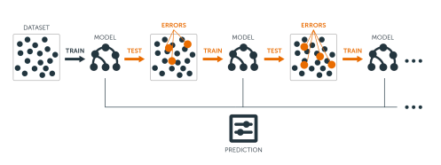
Gradient Boosting Regressor
Gradient Boosting is learning technique that builds multiple decision trees sequentially, each one correcting the errors of its predecessor.

Slide 10
Comparison of Different regressors
Linear Regression: For simple and linear relationships.
Decision Tree: When dealing with non-linear patterns and interpretability is a priority.
Random Forest: For improved performance and robustness against outliers.
Gradient Boosting: When high accuracy is crucial, and longer training times are acceptable.

Slide 11
Lets move to Google collab

